Slide 1
September 2021
Notes:
Quorum needs 51 people to turn up.

Slide 2
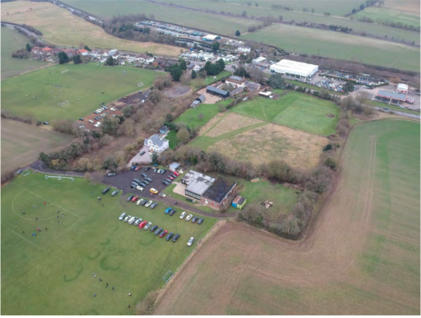
Cow Roast Site
Notes:
Hand over to Simon for update

Slide 3
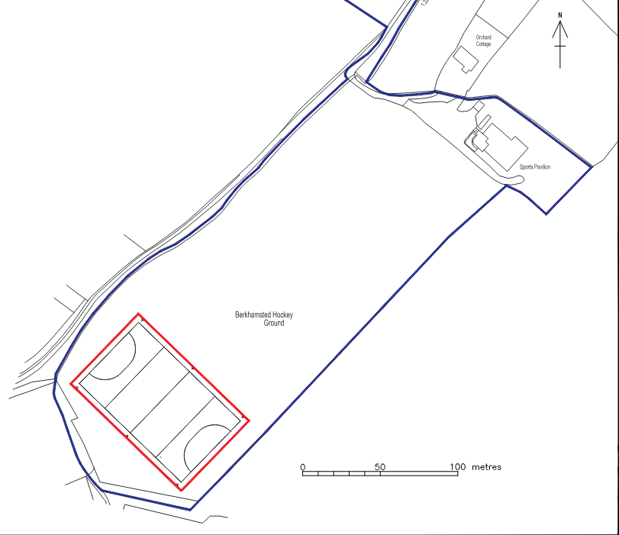
Astroturf
Notes:
Hand over to Simon for update

Slide 4
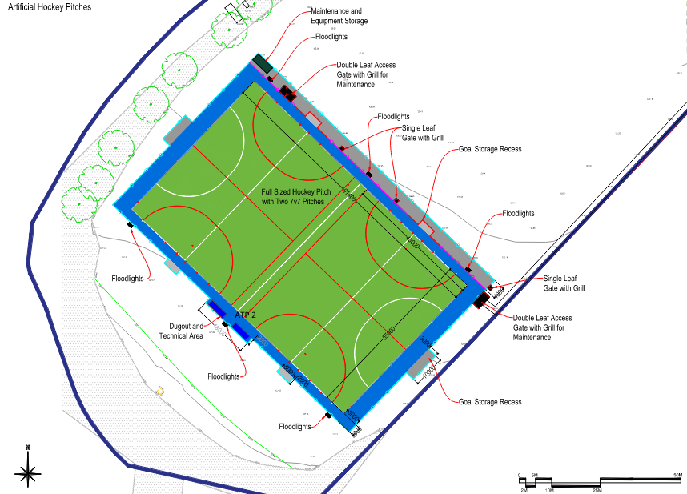
Astroturf
Notes:
Hand over to Simon for update

Slide 5
ASTRO

Slide 6
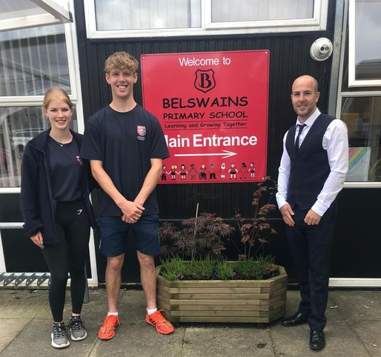
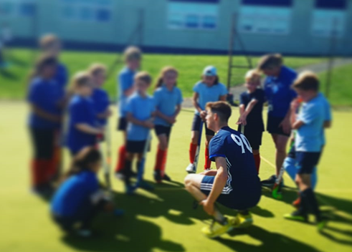
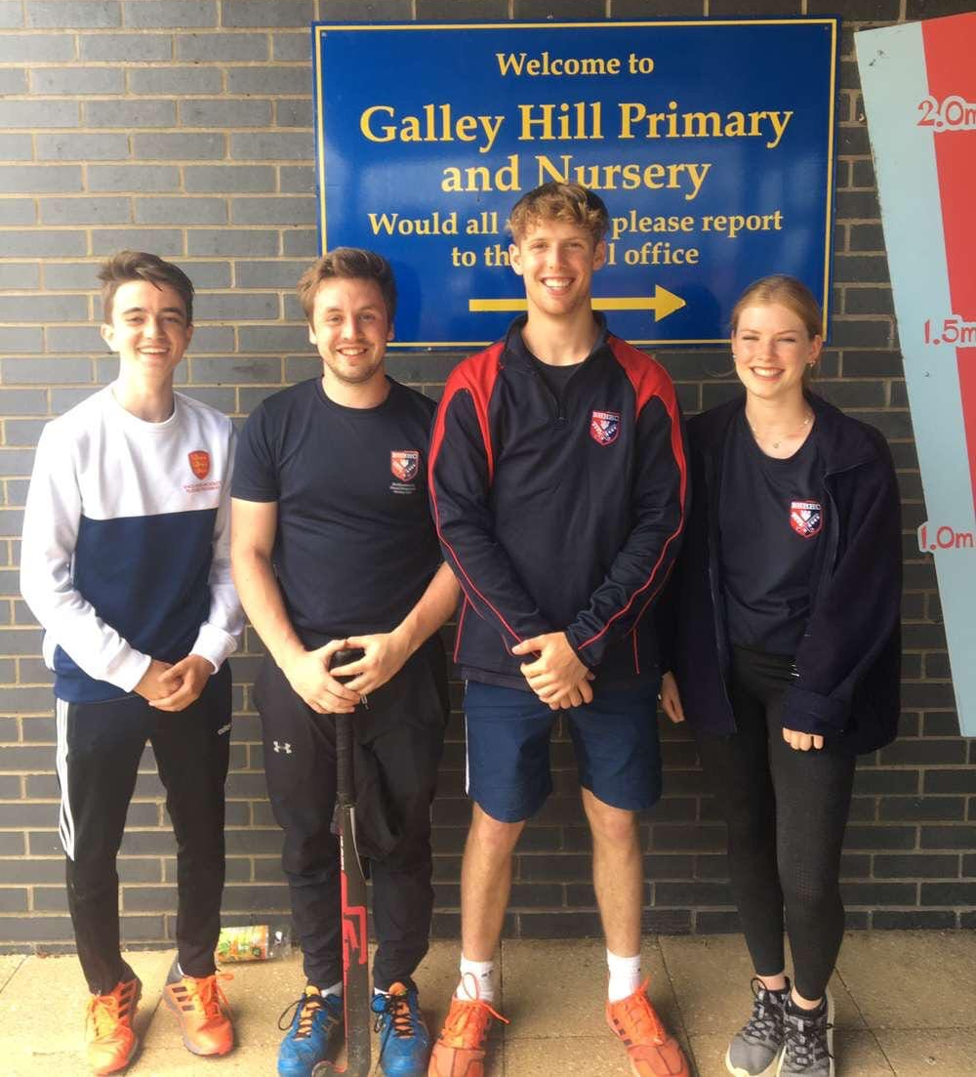
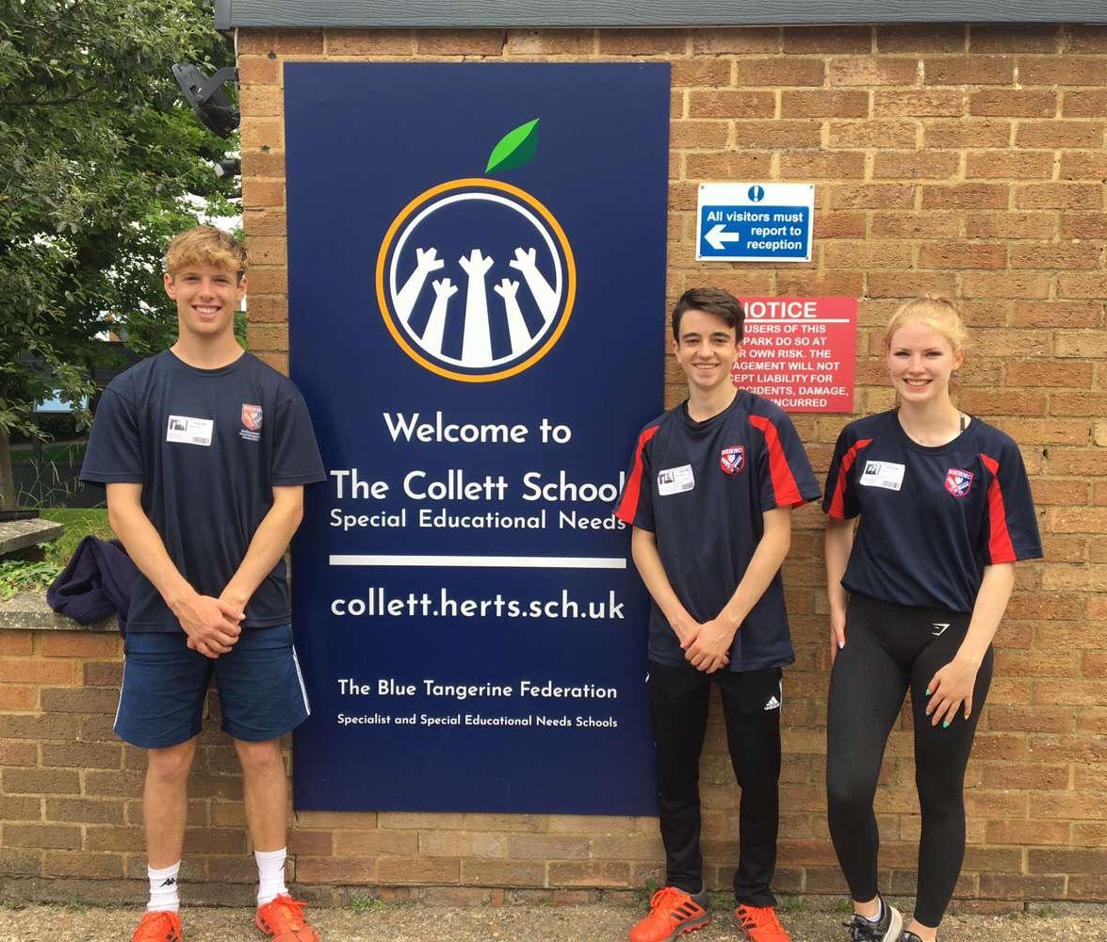
Schools Programme
Notes:
St Marys Northchurch
Belswains Primary School, Barnfield, Hemel Hempstead HP3 9QJ
Bovingdon Primary Academy, 50 High St, Bovingdon, Hemel Hempstead HP3 0HJ
Bridgewater Primary School, Bridle Way, Berkhamsted HP4 1ES
Dagnall VA CofE Primary School, Main Road South, Dagnall, Berkhamsted, HP4 1QX
Great Gaddesden CofE Primary School, Church Meadow, Great Gaddesden, Hemel Hempstead HP1 3BS
Greenway Primary & Nursery School, Crossways, Berkhamsted HP4 3NH
Kings Langley Primary School, Common La, Kings Langley WD4 8DQ
St. Bartholemew CofE Primary School, Common Field, Wigginton, Tring HP23 6EP
The Collett SEN School Secondary School, Hemel Hempstead, HP1 1TQ

Slide 8
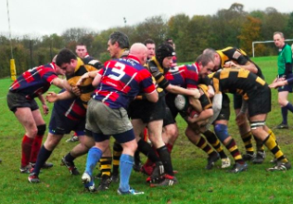
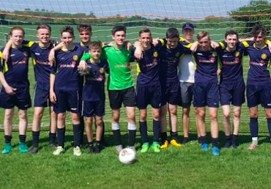
Multi sport club
Notes:
Hand over to Simon for update

Slide 9
Thank You

